Slide 1
Human Activity Recognition With Smartphones
Shubham Aggarwal Mr. Hemant Tulsani
0201480284 (Project Guide)
Amit Kumar Jha 0284802814

Slide 2
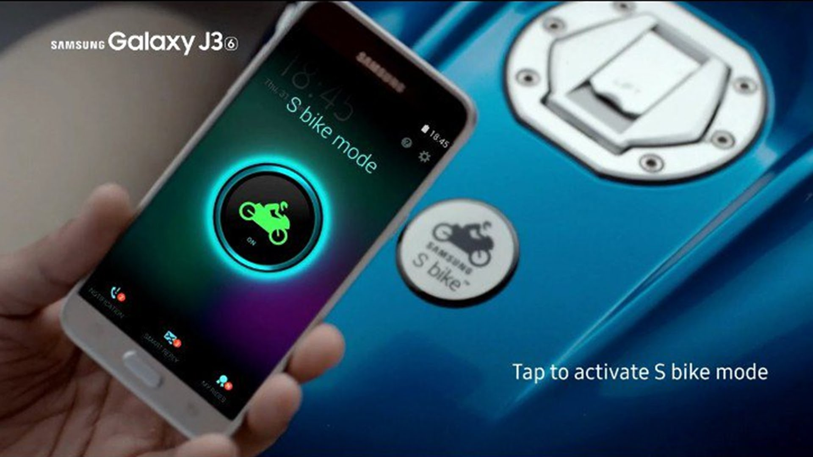
Applying Machine Learning in Electronics world solving real life problems
Eg.
S-Bike Motion Lock ensures that if the S bike mode user decides to take the urgent incoming call, he will need to bring his bike to a halt to be able to answer the call.
This safety feature is designed to encourage responsible riding.

Slide 3
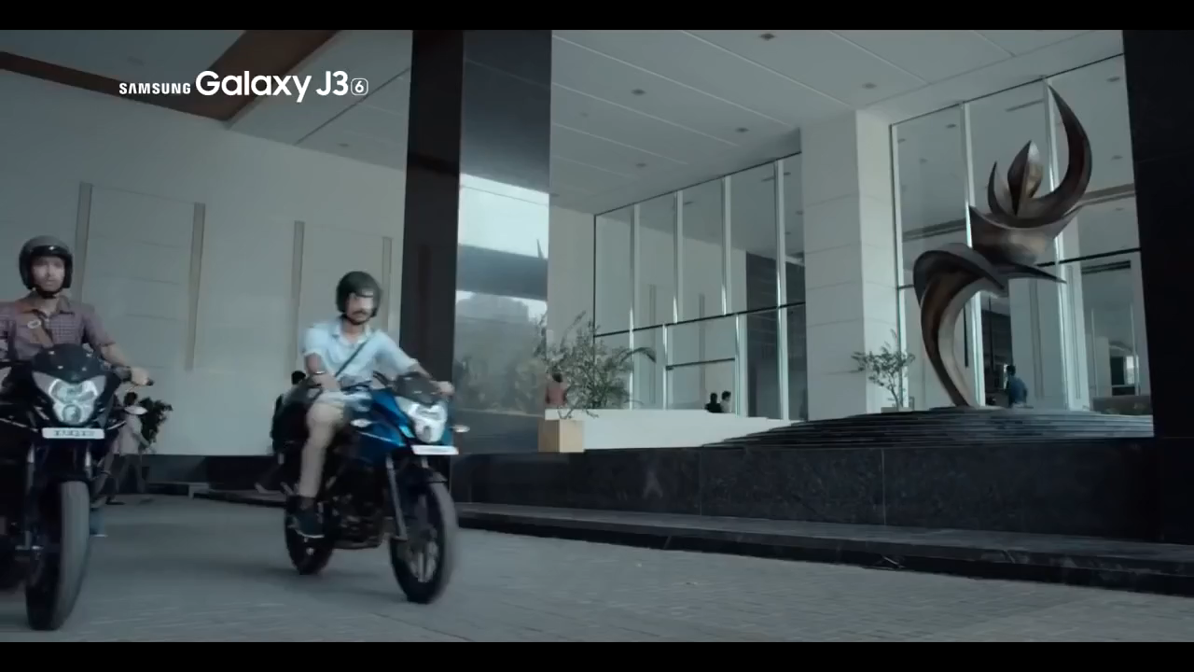

Slide 4

How ???

Slide 5
OBJECTIVE :
The objective is to classify (WALKING, WALKING_UPSTAIRS, WALKING_DOWNSTAIRS, SITTING, STANDING, LAYING) activities using data into one of the six activities performed.
The project uses database which was built previously from the recordings of 30 study participants performing activities of daily living.
The obtained dataset has been partitioned into two sets, where 70% & 30% of the volunteers was selected for generating the training and test data respectively.
Finally, making a predictive model .

Slide 6
DATASET INFORMATION
Each person performed six activities (WALKING, WALKING_UPSTAIRS, WALKING_DOWNSTAIRS, SITTING, STANDING, LAYING) wearing a smartphone (Samsung Galaxy S II) on the waist.
Using its embedded accelerometer and gyroscope, researchers captured 3-axial linear acceleration and 3-axial angular velocity at a constant rate of 50Hz. The experiments have been video-recorded to label the data manually.
The obtained dataset has been randomly partitioned into two sets, where 70% and 30% of the volunteers was selected for generating the training and test data.

Slide 7
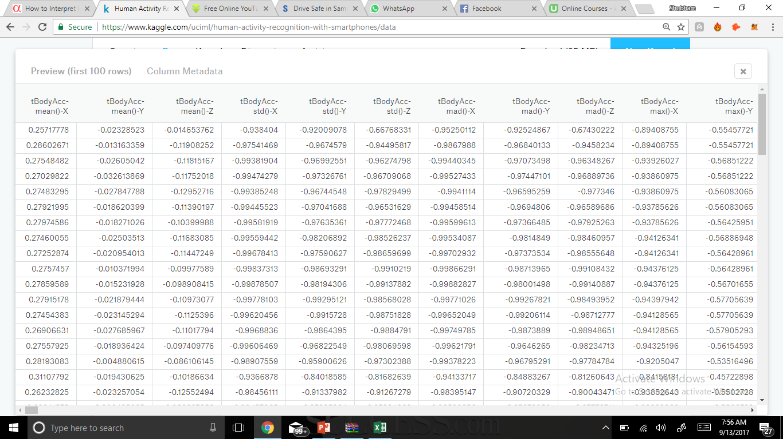
TEST DATASET PREVIEW (first 20 rows)

Slide 8
TECHNIQUES INVOLVED IN MODELLING:
End to End Pipeline process
Data Normalization
Model Evaluation
Accuracy Prediction

Slide 9
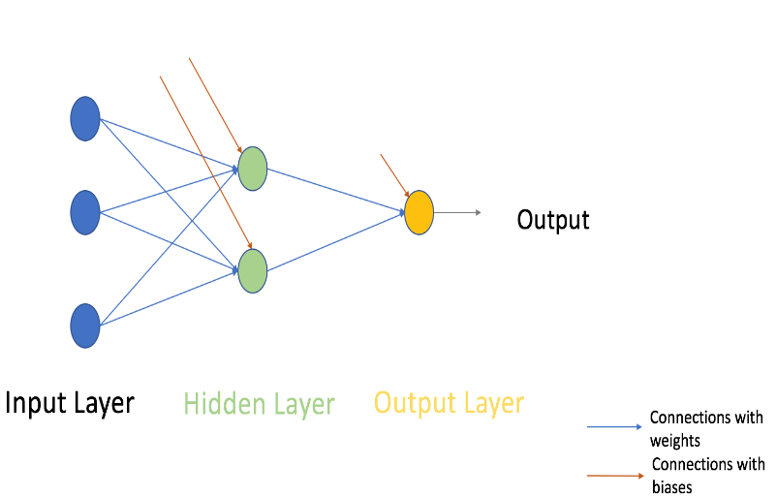
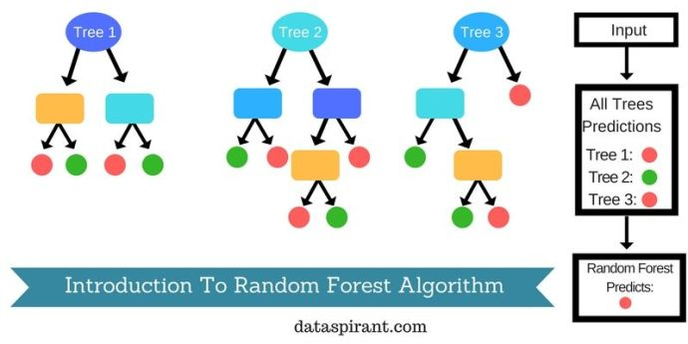
The Main Stuff
Algorithms used :
Artificial Neural Network Random forest

Slide 10
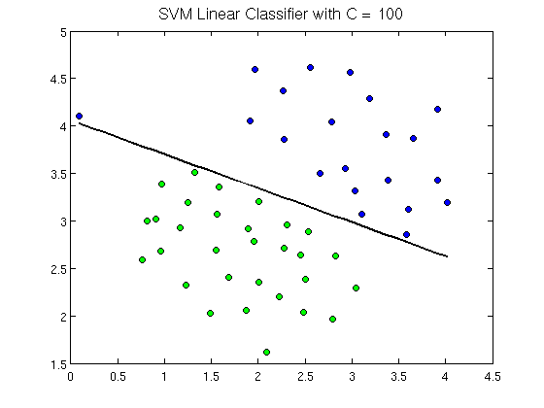
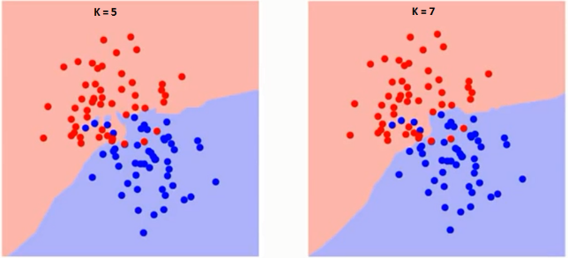
Algorithms used :
SVM K-Nearest Neiughbur

Slide 11
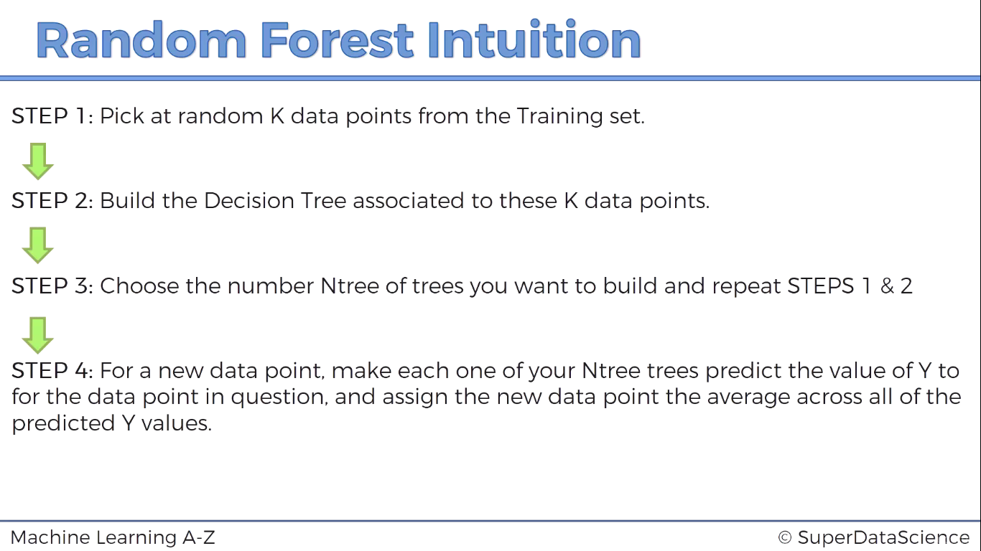

Slide 12
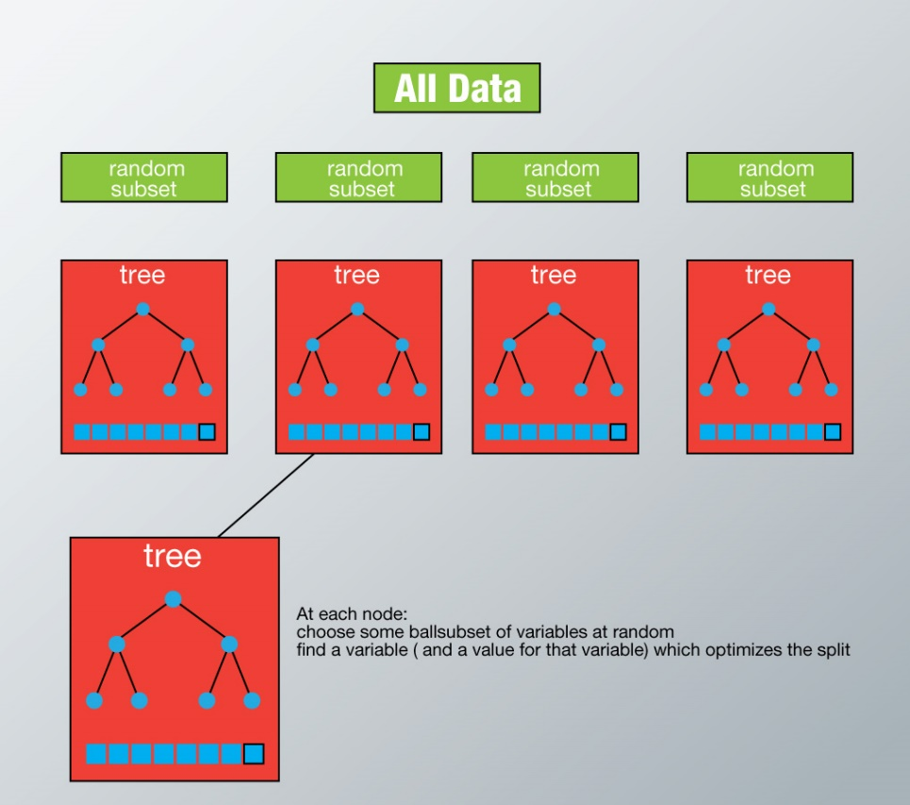
Each tree is grown to the largest extent possible and there is no pruning.
Predict new data by aggregating the predictions of the ntree trees (i.e., majority votes for classification, average for regression).

Slide 13
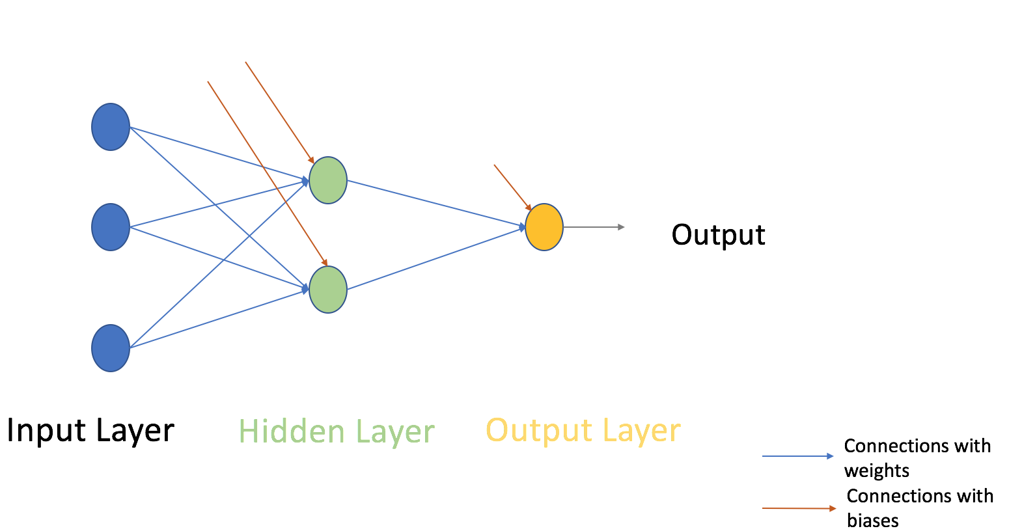
Artificial Neural Networks

Slide 14
By directly combining the input and computing the output based on a threshold value. for eg: Take x1=0, x2=1, x3=1 and setting a threshold =0. So, if x1+x2+x3>0, the output is 1 otherwise 0.
Next, let us add weights to the inputs. example, you assign w1=2, w2=3 and w3=4 to x1, x2 and x3. Multiply input with respective weights and compare with threshold value as w1*x1 + w2*x2 + w3*x3 > threshold. These weights assign more importance to x3 in comparison to x1 and x2.
Next, let us add bias: Each perceptron also has a bias which can be thought of as how much flexible the perceptron is,eg. b in y= ax+b.

Slide 15
We take input and output
initialize weights and biases with random values
take matrix dot product of input and weights assigned to edges between the input and hidden layer then add biases of the hidden layer neurons to respective inputs.
Perform non-linear transformation using an activation function (Sigmoid). Sigmoid will return the output as 1/(1 + exp(-x)).

Slide 16
Perform a linear transformation on hidden layer activation.
Compare prediction with actual output and calculate the gradient of error (Actual – Predicted). Error is the mean square loss = ((Y-t)^2)/2
Compute the slope/ gradient of hidden and output layer neurons
Compute change factor(delta) at output layer
the error will propagate back into the network which means error at hidden layer.

Slide 17
Compute change factor(delta) at hidden layer, multiply the error at hidden layer with slope of hidden layer activation
Update weights at the output and hidden layer: The weights in the network can be updated from the errors calculated for training example(s).
Update biases at the output and hidden layer: The biases in the network can be updated from the aggregated errors at that neuron.

Slide 18
K-Nearest Neighbors
Non-parametric method used for classification and regression
An object is classified by a majority vote of its neighbors, with the object being assigned to the class most common among its k nearest neighbors (k is a positive integer, typically small)
In k-NN regression, the output is the property value for the object. This value is the average of the values of its k nearest neighbors.

Slide 19
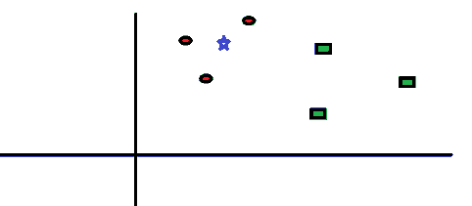
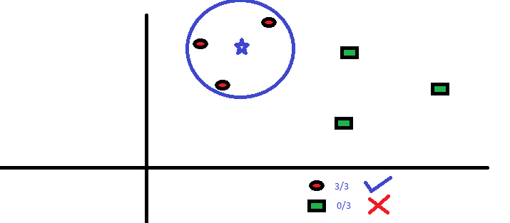

Slide 20
Support vector Machine
Support vector machines (SVMs, also support vector networks) are supervised learning models with associated learning algorithms
Each data item is plotted as a point in n-dimensional space (where n is number of features you have) with the value of each feature being the value of a particular coordinate.
Classification is performed by finding the hyper-plane that differentiate the two classes very well.

Slide 21
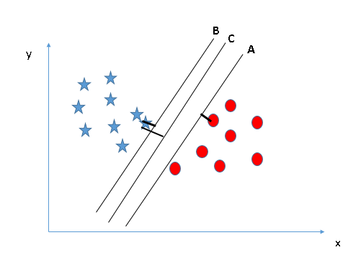
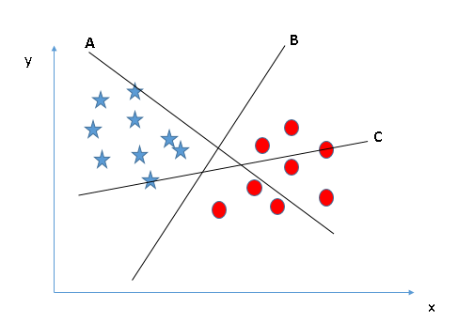
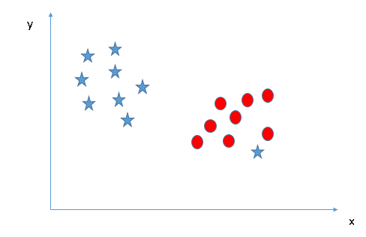
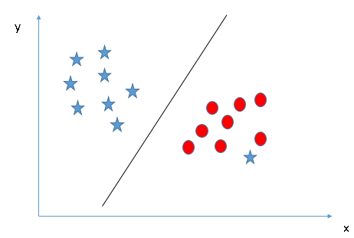

Slide 22
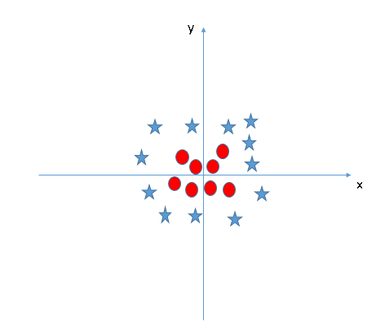
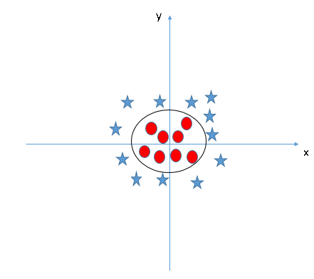
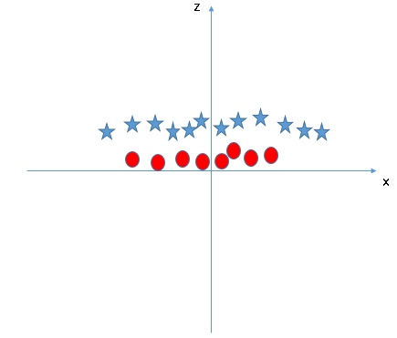

Slide 23
RESULTS
1. Artificial Neural Networks
2. Random Forest
Training set score
SGD:0.979733
Test set score
SGD: 0.953851
Training set score
0.999864
Test set score
0.892772

Slide 24
RESULTS
3. KNN
4. SVM
Training set score
1.0
Test set score
0. 819138
Training set score
Test set score
0.965389
0.994559

Slide 25
CONCLUSION
Support vector machine gives the most accurate predicted result with test data accuracy of 96.53%.
Desired model is achieved

Slide 26
REFERENCES
https://www.kaggle.com/uciml
http://archive.ics.uci.edu/ml/datasets/Human+Activity+Recognition+Using+Smartphones
https://www.analyticsvidhya.com/blog/2017/07/debugging-neural-network-with-tensorboard/
https://www.analyticsvidhya.com/blog/2017/05/neural-network-from-scratch-in-python-and-r/
https://www.analyticsvidhya.com/blog/2015/11/free-resources-beginners-deep-learning-neural-network/
Relevant course
Machine Learning A-Z™: Hands-On Python & R In Data Science by UDEMY
Relevant papers
Davide Anguita, Alessandro Ghio, Luca Oneto, Xavier Parra and Jorge L. Reyes-Ortiz. Human Activity Recognition on Smartphones using a Multiclass Hardware-Friendly Support Vector Machine. International Workshop of Ambient Assisted Living (IWAAL 2012). Vitoria-Gasteiz, Spain. Dec 2012

Slide 27
THANK YOU !!!!!

